Slide 1
Plattform für Sustainable Economy,
Smart City und Umwelttechnik
Wie Parkdaten zur nachhaltigen Mobilität beitragen
Kau Abele Smart City System

Slide 2
pbs.org/americanexperience
Flickr | License details
Creator: Kyle Harris
Notes:
1913 assembly line production (research)
1000 cars/day
accessability

Slide 3
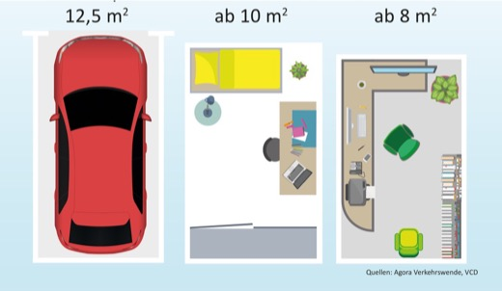
Reaching the Limit

Slide 4
Notes:
3. Imagine:
We in the parking branch supporting sustainability while at the same time increasing our business opprtunities as we build the necessary tools for not only gathering parking data but to also bring these together.
If you want to talk about this some more, visit us at booth 12.602 in the parking hall.

Slide 5
www.sustainability-days.ch

